Slide 1
Los Angeles County
Office of Cannabis Management
Cannabis in the Era of Regulation
October 24, 2018
Julia Orozco
Manager, Office of Cannabis Management

Slide 2
The (Rocky) Road to Regulation: Evolution of California’s cannabis laws

Slide 3
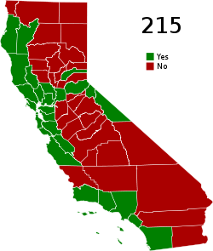
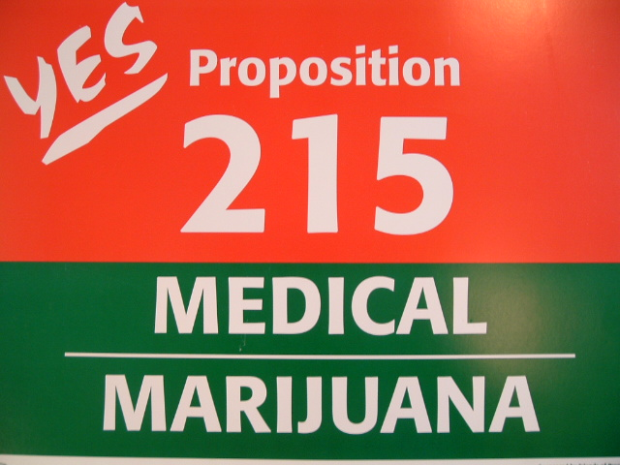
California legalizes medical cannabis…
1996: Prop. 215 “Compassionate Use Act”
Allowed qualified patients with a valid doctor’s recommendation to possess and cultivate cannabis for personal medical use

Slide 4
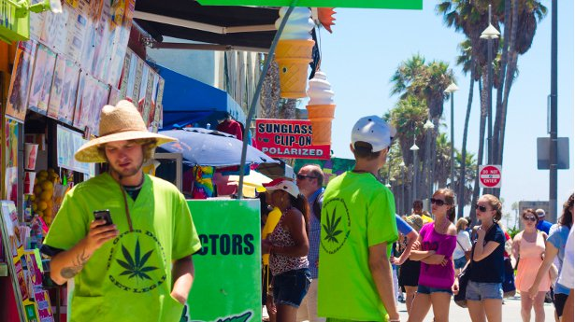
… but doesn’t vigorously regulate it
Consumer safety
Public safety
Youth access and use
Quality of life issues
Notes:
No consumer protection standards
No labeling or packaging requirements
No pesticide rules
Ineffective control over doctor “recommendations”

Slide 5
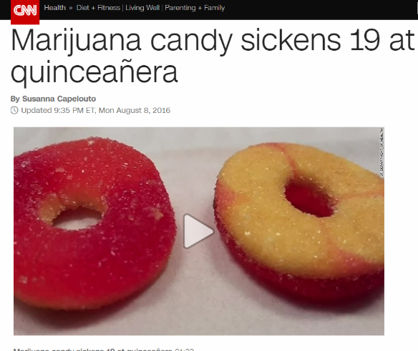
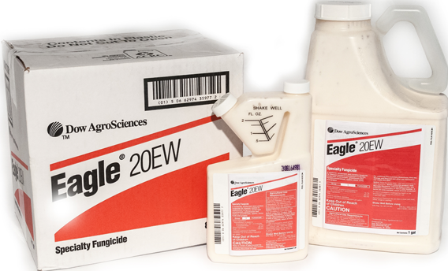
Consumer Safety
Labeling and product information
Pesticides, mold and other contaminants
Potency and homogenization
Notes:
No consumer protection standards
No labeling or packaging requirements
No pesticide rules
Ineffective control over doctor “recommendations”

Slide 6
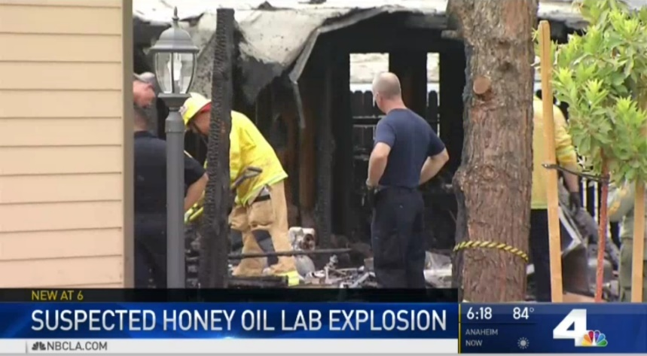
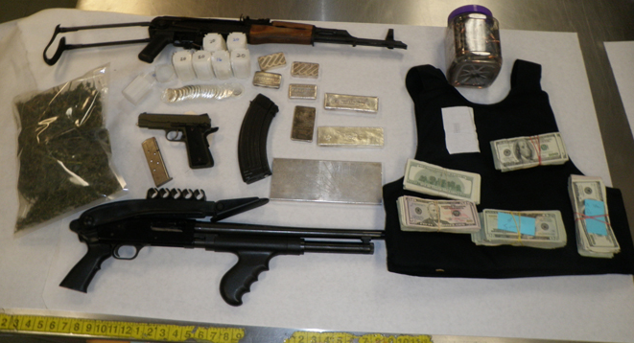
Public Safety
Butane honey oil (BHO) lab explosions
Organized crime
Notes:
No consumer protection standards
No labeling or packaging requirements
No pesticide rules
Ineffective control over doctor “recommendations”

Slide 7
Youth Access and Use
Age verification
Packaging
Notes:
No consumer protection standards
No labeling or packaging requirements
No pesticide rules
Ineffective control over doctor “recommendations”

Slide 8
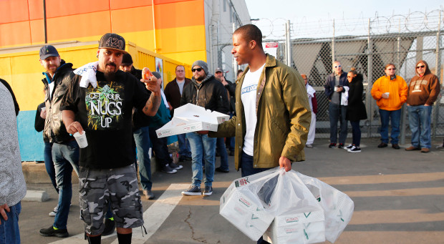
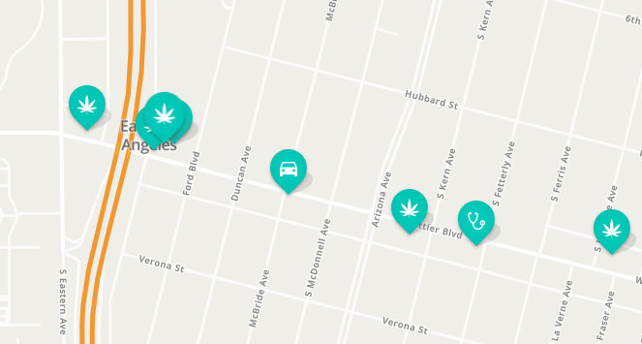
Quality of life issues
Loitering, public consumption
Overconcentration
East Los Angeles
Notes:
No consumer protection standards
No labeling or packaging requirements
No pesticide rules
Ineffective control over doctor “recommendations”

Slide 9
Proliferation and Overconcentration
1
2
3
4
6
5

Slide 10
Since then…
2015-16: Medical Cannabis Regulation and Safety Act (MCRSA)
Legalized medical Cannabis
Nov. 2016: Prop. 64/Adult-Use of Marijuana Act (AUMA)
June 2017: Medical and Adult-Use Cannabis Regulation and Safety Act (MAUCRSA)
Legalized nonmedical or adult-use cannabis possession, cultivation and use
Required State of California to license commercial adult-use cannabis businesses by Jan. 1, 2018
MCRSA + AUMA = MAUCRSA
One regulatory framework
Adopted by California Legislature as a cleanup bill
Repealed MCRSA and amends AUMA to include regulations for medical cannabis

Slide 11
Shifting federal approach to cannabis
1970: federal Controlled Substances Act
Cannabis in Schedule 1: no valid medical uses and a high potential for abuse
2013: “Cole Memorandum”
Obama era guidance to federal prosecutors to de-prioritize prosecution of state-compliance cannabis businesses
Rescinded by Attorney General Jeff Sessions on January 4, 2018
December 2014: Rohrabacher-Farr (now, Rohrabacher-Blumenauer) Budget Amendment
Prevents Justice Department from spending funds to interfere with the implementation of state medical marijuana laws
April 13, 2018: Trump “commitment” to cannabis legal states?
Several bills being developed in congress to reduce federal restrictions
Notes:
Established categories, or schedules, into which individual drugs were placed depending on their perceived medical usefulness and potential for abuse

Slide 12
Los Angeles County Approach to Regulation

Slide 13
Board Priorities
February 2017: Board of Supervisors directed OCM to work with Public Health, Regional Planning, and other departments to prepare regulations to allow, license, and regulate all types of cannabis businesses
Priority areas from February 2017 motion
Transition from an unlicensed market to a regulated market
Protect county neighborhoods
Prevent overconcentration and ensure equity in siting
Youth prevention
Consumer protection

Slide 14
Board Priorities
November 7, 2017: Board directed OCM, DPH/Center for Health Equity, and County Counsel to incorporate health equity models to reduce disparate impacts of cannabis in forthcoming regulations
Discretionary hearing process for cannabis retailers
Grant program to bolster youth development programs, substance use disorder treatment, drug prevention, and community development in high-needs areas
Strategic phased-in licensing that balances need to transition from an unlicensed market to a regulated one with a precautionary approach to licensing
Health Impact Assessment:
County Department of Public Health to conduct a health impact assessment to identify unincorporated areas with relatively poor health outcomes and evaluate how adding a cannabis business to that area could affect health
Foundational tool for permitting decisions and establishes a baseline against which to measure changing conditions

Slide 15
Board Priorities
June 19, 2018: OCM submitted a report outlining a cannabis licensing framework as directed by the BOS for consideration.
The BOS is in the process of reviewing the proposal and has not taken action to authorize commercial cannabis licensing in unincorporated areas.
The BOS has directed the focus of OCM other cannabis related priorities.

Slide 16
Board Priorities
February 13, 2018: Board directed OCM and other departments and relevant government agencies and stakeholders to develop recommendations on cannabis-related decriminalization and disparities
Countywide plan on cannabis resentencing and reclassification
Assessment of data tracking mechanisms to measure and prevent disproportionate enforcement of cannabis-related offenses
June 26, 2018: Board directed the Interim Director of the Department of Consumer and Business Affairs to report on the potential implementation of a universal emblem program that would allow consumers to easily determine whether a cannabis store is licensed
Education Campaign
Local or statewide implementation
July 3, 2018: Board directed OCM and other departments to present an unlicensed cannabis business elimination plan
Multi-pronged strategy

Slide 17
OCM Initiatives

Slide 18
OCM Initiatives
Public Outreach
Health Impact Assessment
Data Dashboard
Resentencing
Unlicensed Business Closure

Slide 19
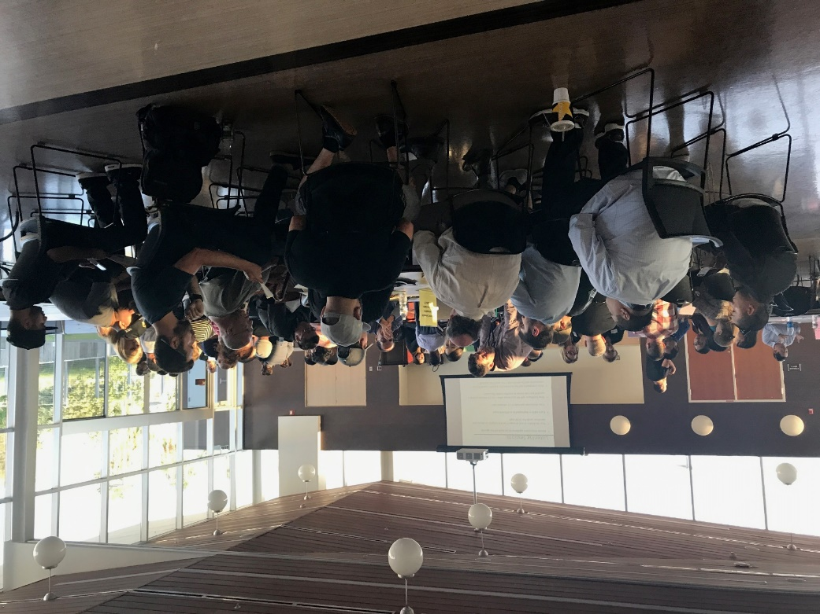
Public Outreach – Public Listening Sessions
20 public workshops
“Tabletop” format with professional facilitators
Background information and discussion questions were offered in multiple languages and translators were available

Slide 20
Public Outreach – Community Meetings
12 community groups and town councils
General background on cannabis law
Draft proposed County policies
Unlicensed business enforcement plan

Slide 21
Public Outreach – Advisory Working Group
17 members, with representatives appointed by each supervisorial district, and diverse perspectives including public health experts, education officials, local elected officials, cannabis industry reps, university professors, and community stakeholders
The Advisory Working Group reached consensus on 64 recommendations regarding cannabis regulations and best practices in unincorporated areas

Slide 22
Public Outreach – City Engagement
Promote regional approach to cannabis regulation and best practices
Coordinate services provided to cities
LA County Regulators Round Table

Slide 23
Public Outreach – Youth Prevention Campaign
Youth-produced
Emphasis on social media marketing
www.letstalkcannabislacounty.com

Slide 24
Health Impact Assessment
Notes:
.

Slide 25
Health Impact Assessment
CEQA for Cannabis Public Health
Estimate health and health equity impacts for proposed regulations and policy
Evidence-based, health-protecting cannabis business and regulatory practices

Slide 26
Health Impact Assessment
Guidance for a proposed Cannabis Commission
Ongoing monitoring of health impacts to inform policy

Slide 27
Data Dashboard

Slide 28
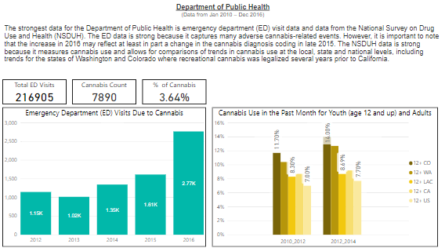
Data Dashboard
Cannabis-related data from departments
Phased Approach
Phase I – Data collection
Phase II – Theme development

Slide 29
Resentencing
Notes:
Wanted to provide real quick background on cannabis laws before going into detail about our office.

Slide 30
Resentencing
Assist individuals with prior cannabis convictions who qualify for legal relief under new state laws
AB 1793: Cannabis Resentencing
OCM is coordinating with the Public Defender and District Attorney to develop a proactive resentencing plan
Use of technology is being considered to assist the County’s efforts
Notes:
Prop 64 decriminalized and allowed for expungement or reclassification of certain claims: misdemeanor expunged, felony reclassified
Code for America will provide an easy online application for clearing someone’s record, “Clear My Record”
Also the DA is looking to utilize a tech platform for searching records to identify applicable candidates

Slide 31
Unlicensed Closure

Slide 32
Unlicensed Closure – Multi-Pronged Strategy
Public Education and Outreach
Enhanced Direct Enforcement
Legislative Advocacy
Strategic Partnerships

Slide 33
Q & A

Slide 34
Contact the Office of Cannabis Management
Website: http://cannabis.lacounty.gov
Email: cannabis@lacounty.gov

